Slide 1
Dental Health Management system

Slide 2
Introduction
A web-based application that helps the dentists and staff in managing and operating the dental clinic.
Functionalities –
Managing patient’s dental records
Appointment handling
Treatment tracking
Inventory management of dental supplies and equipment
Includes a database system that facilitates information retrieval and medical report generation.

Slide 3
Requirements
This database should primarily support Online Transaction Processing (OLTP) Methodology
Entities of project - Login Details, Users, Appointments, Treatments, Billing, Orders, Products, Vendors
Includes user authentication – Username and password
Includes a PL-SQL procedure to send automated emails for appointment reminder
Different privileges granted as per user type

Slide 4
Assumptions
Designed specifically for single location-based clinic
Dental clinic system mainly accessed via online web interface
System can have multiple users
Patient can book only one appointment per day
At least one dentist is available everyday
A single vendor can sell multiple products
Patient is always assumed to be self-insured only

Slide 5
User-Functionalities
Admin
01
Super-User; has accessibility privilege over the entire system
Dentist
02
View the patient details ;Edit's treatment details and prescribes medicines
03
Staff
Handles basic operation of clinic and inventory
04
Patient
Can modify personal details and view appointment details and prescriptions
05
Vendor
View or modify product details

Slide 6
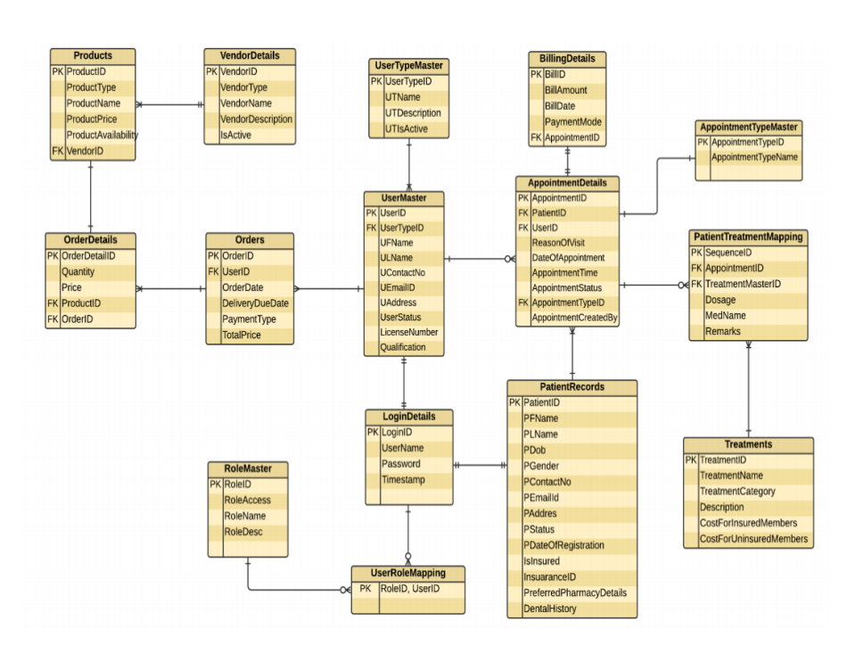
Entity Relationship Diagram

Slide 7
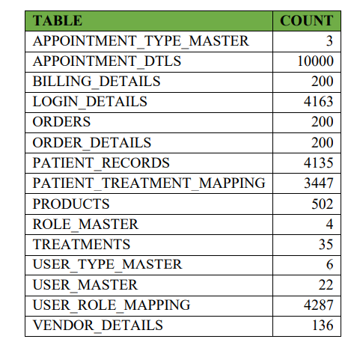
Database Tables
Following are the list of the tables that are present in our database and their record count .

Slide 8
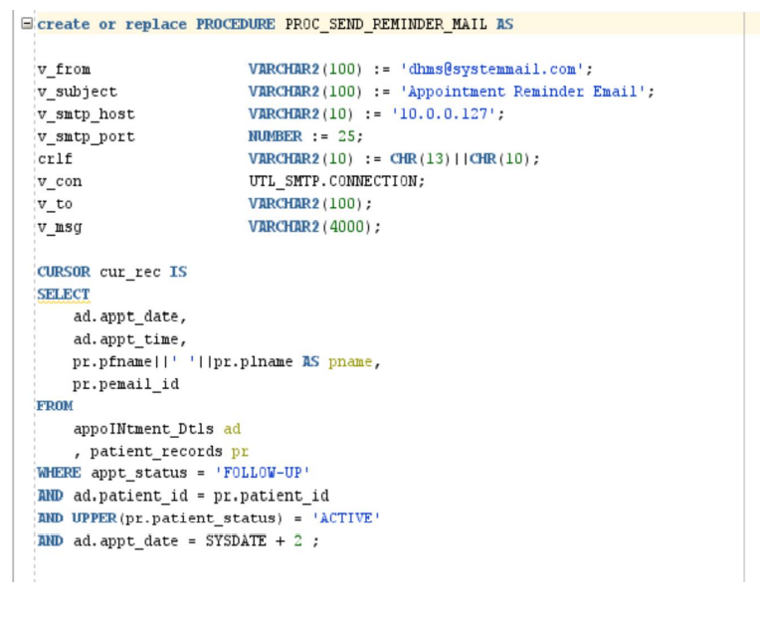
Database Programming
Procedure to send automated emails for Appointment Reminder

Slide 9
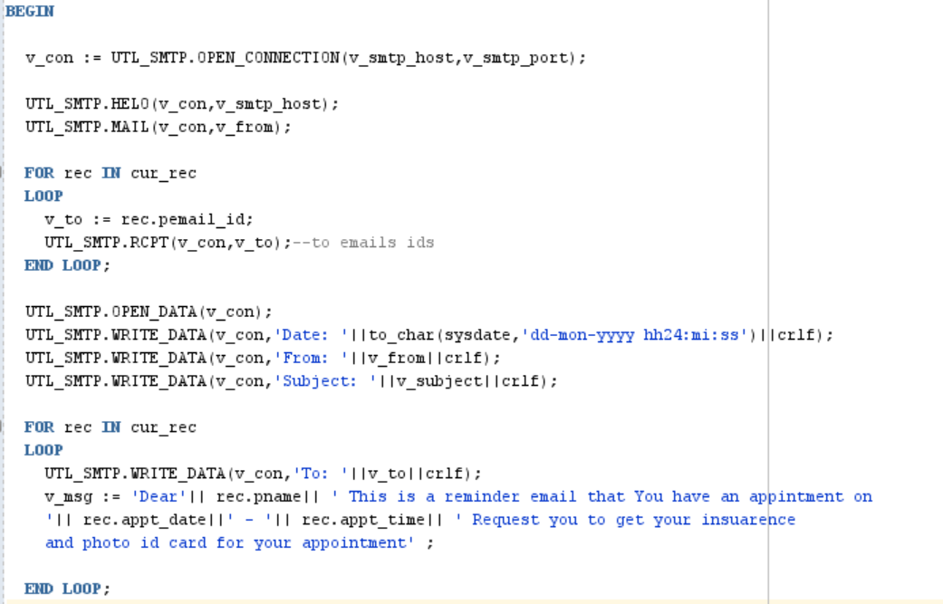
Continued..

Slide 10
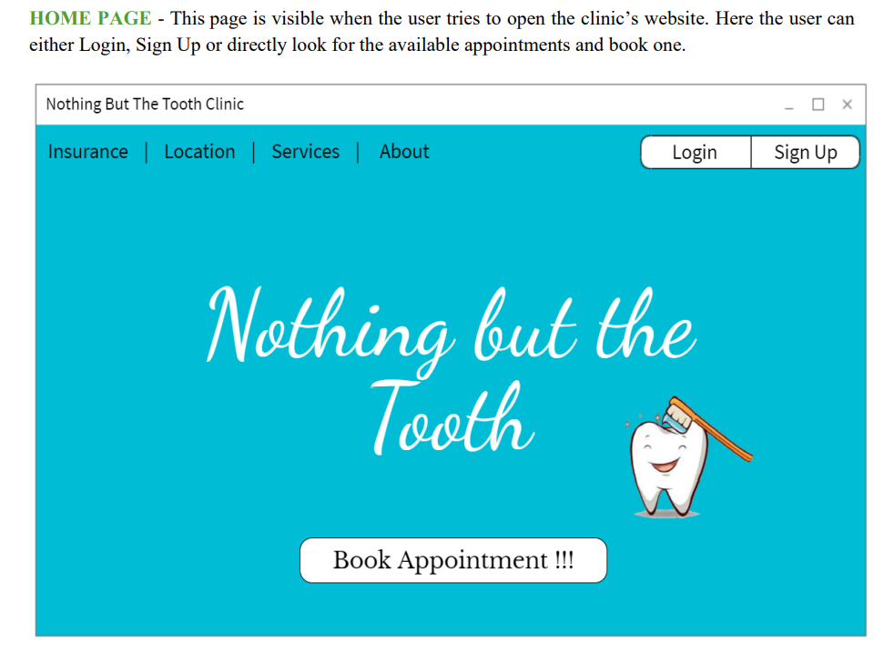
User Interface Mock – Ups

Slide 11
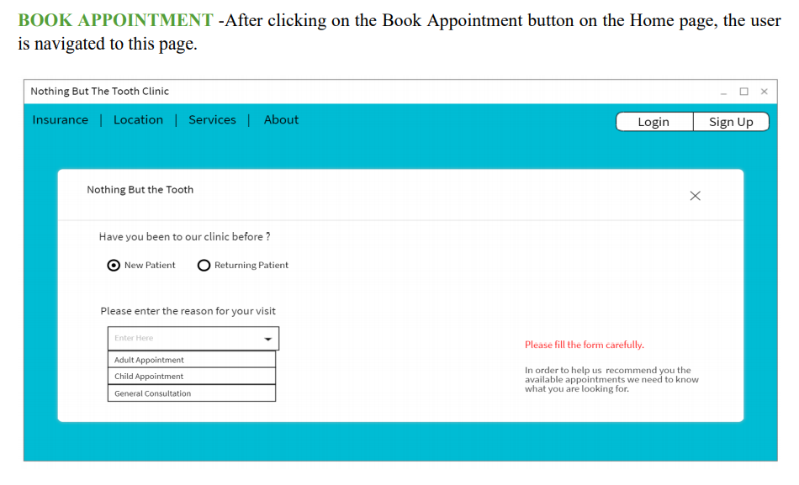

Slide 12
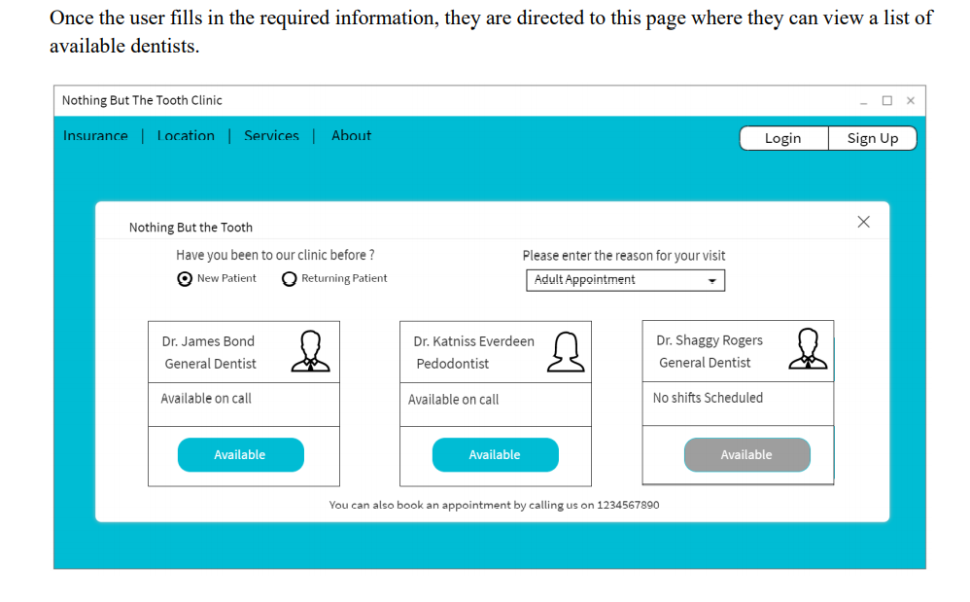

Slide 13
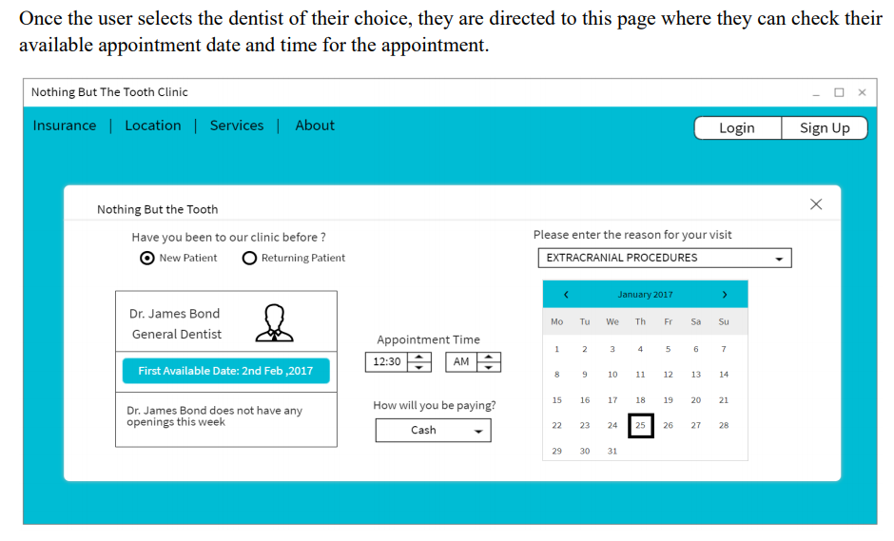

Slide 14
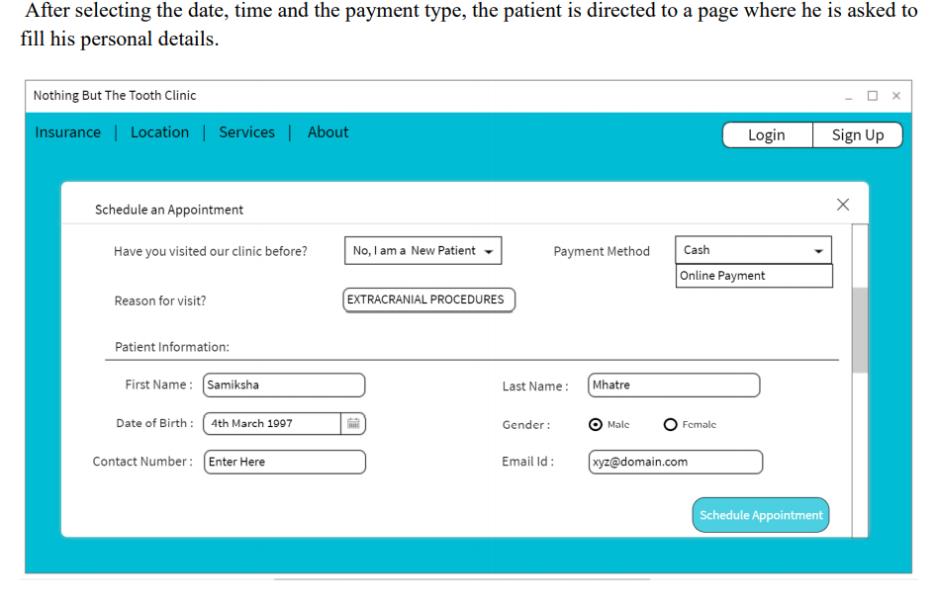

Slide 15
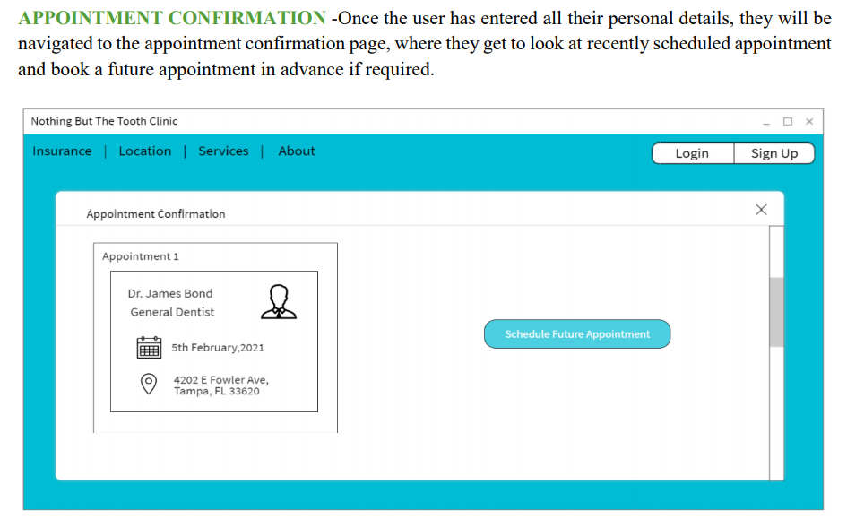

Slide 16
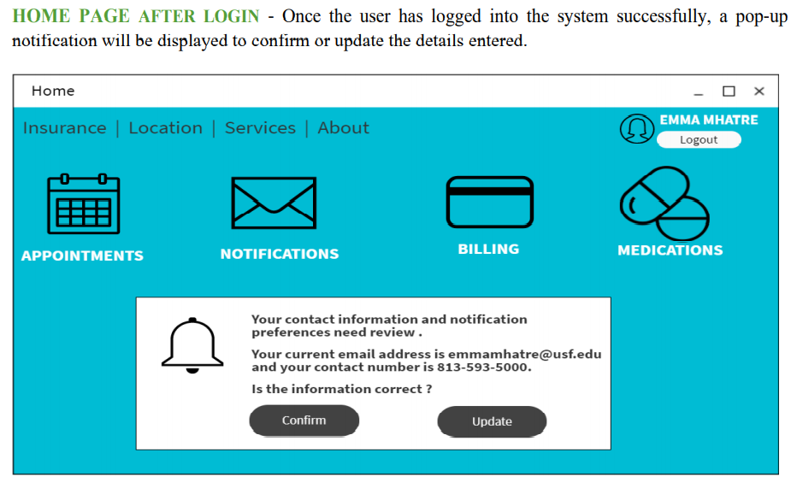

Slide 17
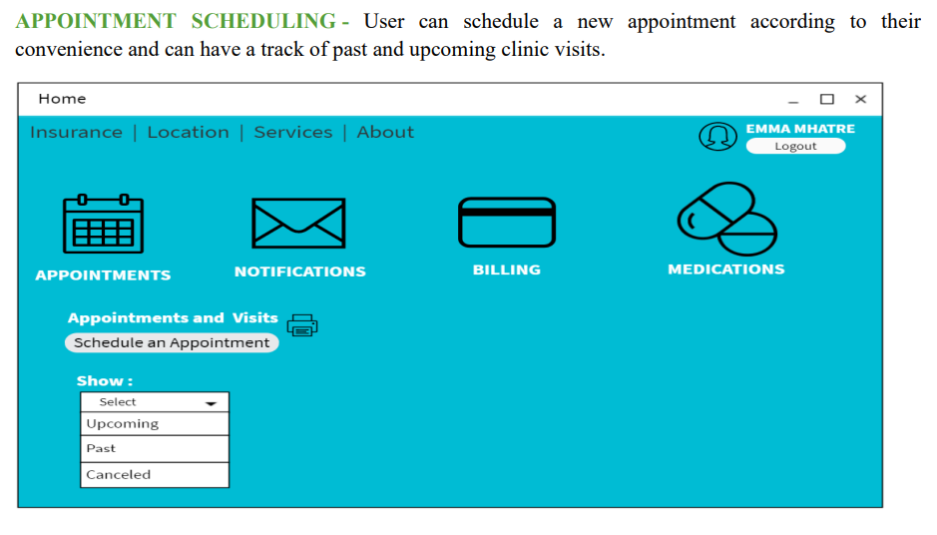

Slide 18
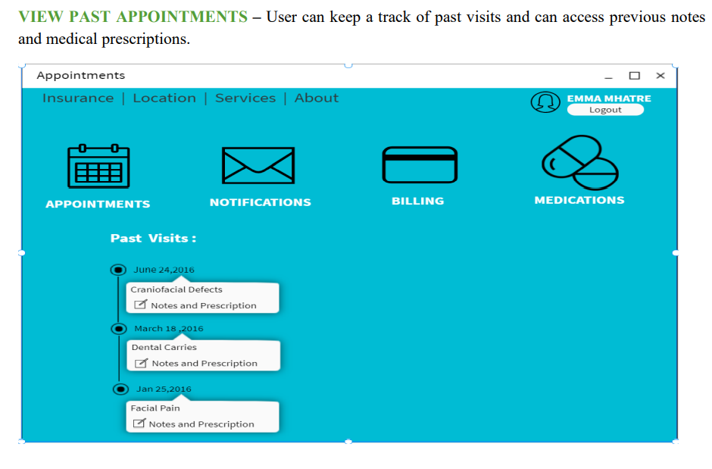

Slide 19
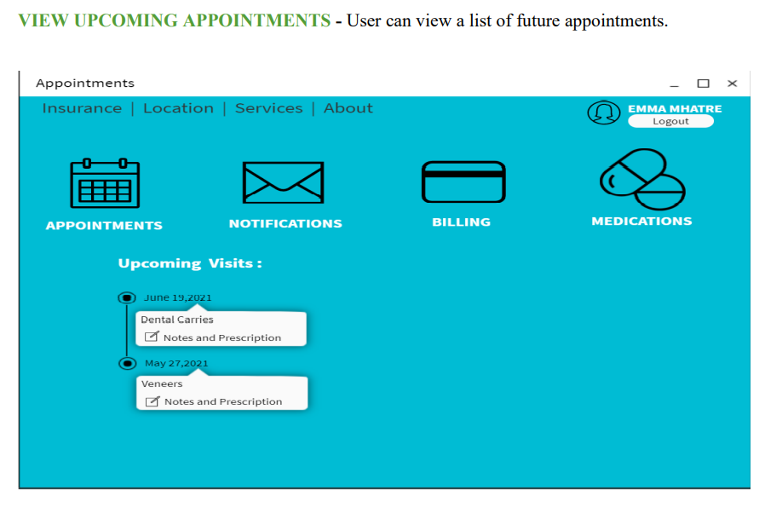

Slide 20
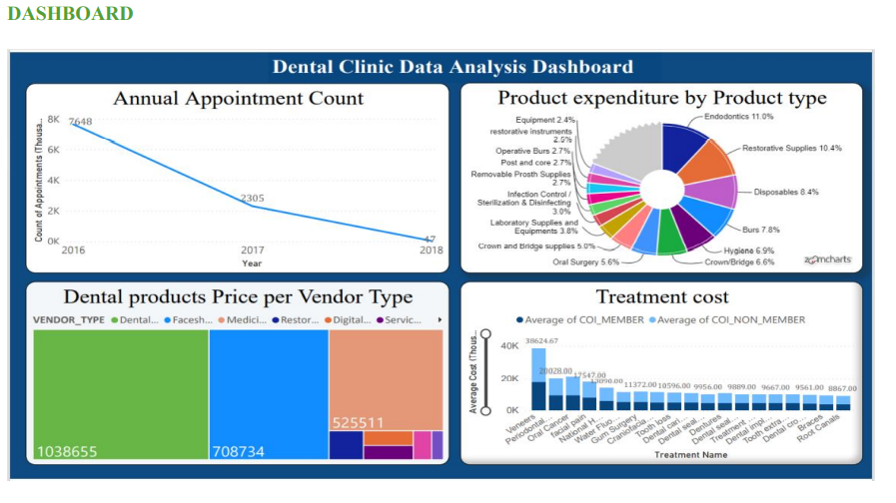
Data Visualization-Power BI

Slide 21
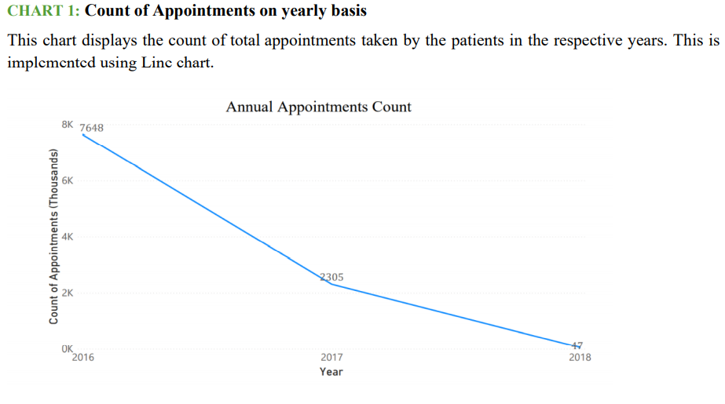

Slide 22
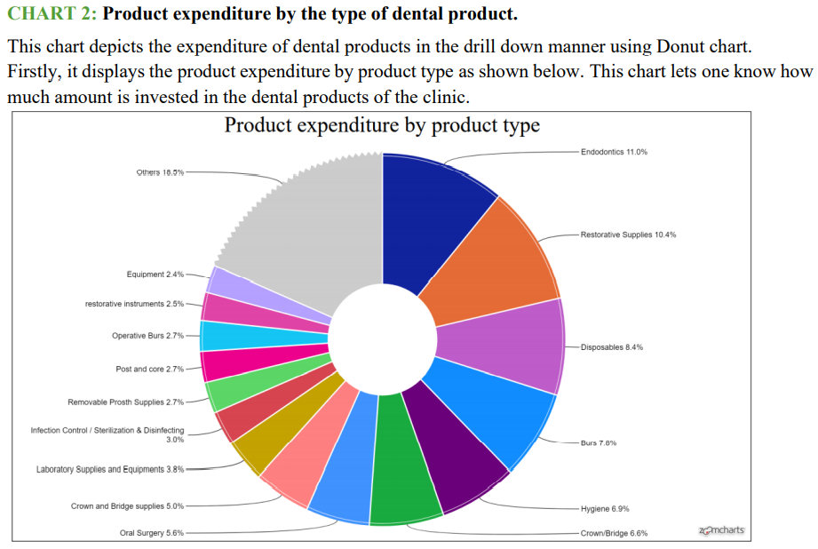

Slide 23
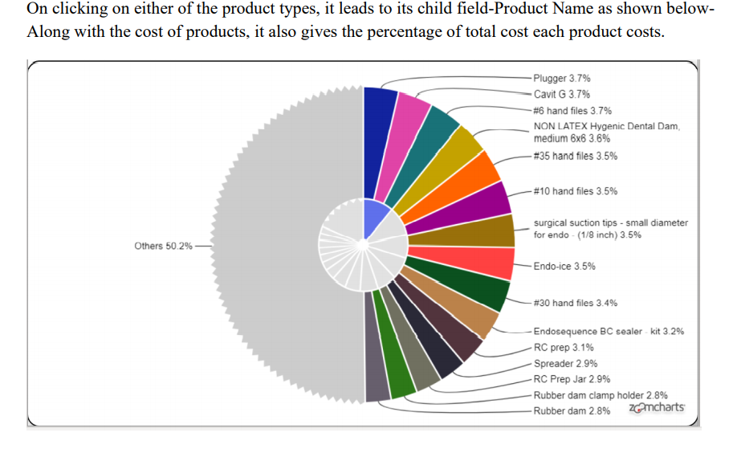

Slide 24
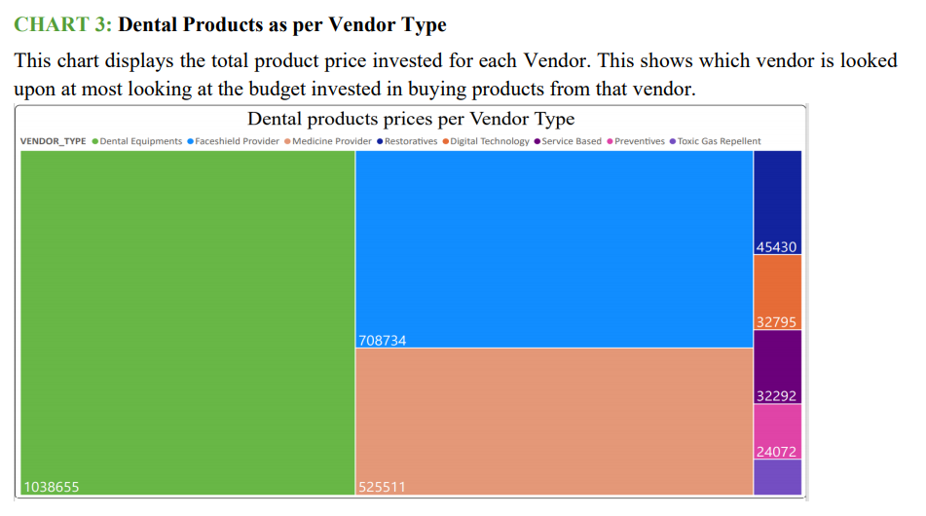

Slide 25
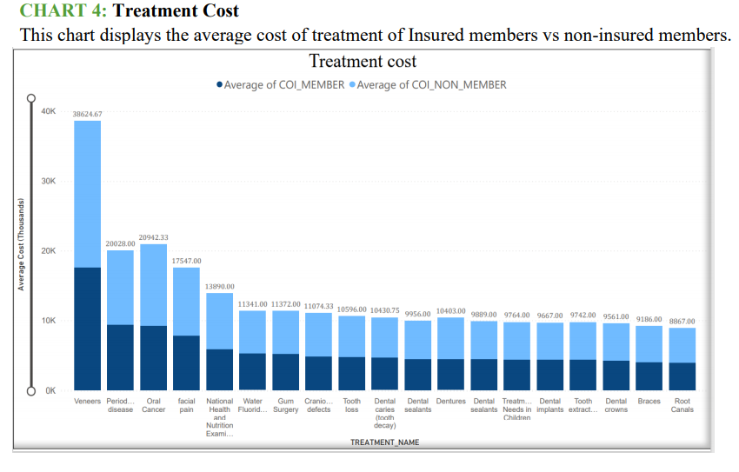

Slide 26
Future Scope
Appointment availability feature can be added via temporary table creation.
The database system can be extended to a large-scale clinic management system by adding data on more branches of the clinic.
The system can further be extended to provide online diagnostics and
consultation
Inventory Management: It can be extended further by introducing multiple
vendors and integrating tender management systems.
Financial Accounting: System can take care of the fees that patient pays for the
treatment.
Insurance Beneficiaries: System can be expanded further to the beneficiaries of
insurance policy.

Slide 27
THANK YOU

